Slide 1
Assignment 2
Analyzing Data with Power BI
Akshat Patel - 200501942
22S Data Manipulation Techniques - 04 BDAT1000–22S-30629

Slide 2
Title : Realtor-data.csv
Questions arises from this data set are :
What is average price of house as per cities ?
What is average price per bed room ?
What are the Percentage of house by Bed Room count?

Slide 3
Link of data-set :
https://www.kaggle.com/datasets/ahmedshahriarsakib/usa-real-estate-dataset
Data range :
It has house selling data of 3 states from 1964 to 2021 of America.
It has total 12 different variables.
It has multiple columns which we can measure/aggregate to analyze the data.
City
State
Date
Bed number
Bathroom numbers
Price of house

Slide 4

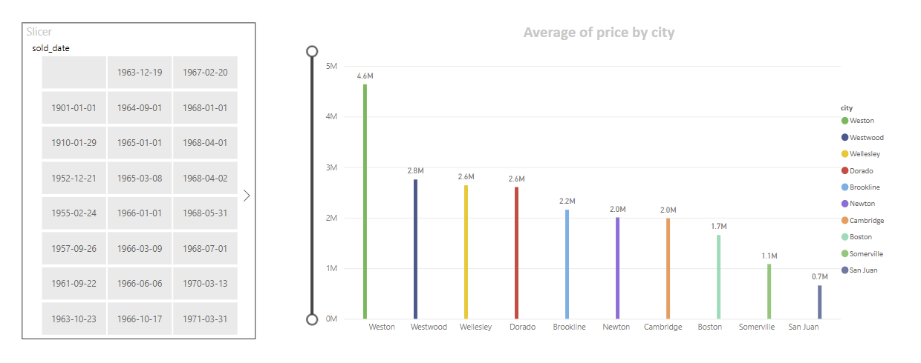
Average Price by city

Slide 5
Title : death-rates-from-air-pollution.csv
Questions arises from this data set are :
What is Death ratio of 4 different variable?
Avg Deaths of 4 different types of pollution by counties.
Total number of deaths every year by 4 different types of pollution.

Slide 6
Link of data-set :
https://www.kaggle.com/datasets/programmerrdai/air-pollution
Data range :
It has data of number of deaths occurred by 4 types of pollution by different country.
It has total 7 different variables.
It has multiple columns which we can measure/aggregate to analyze the data.
Country
Country code
year
Household air pollution from solid fuelsPrice of house
Ambient particulate matter pollution
Air pollution
Ambient ozone pollution

Slide 7
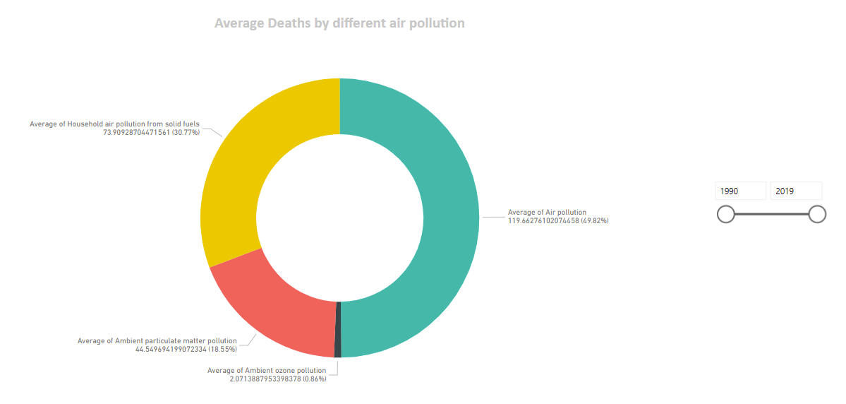
Average deaths by different air pollution

Slide 8
Title : airline_passenger_satisfaction.csv
Questions arises from this data set are :
What are the rating of different facilities by class?
Arrival delay and departure delay by class.
Percentage of class by Purpose of the flight (Business/Personal)

Slide 9
Link of data-set :
https://www.kaggle.com/datasets/mysarahmadbhat/airline-passenger-satisfaction
Data range :
It has data of rating on different facilities of flights.
It has total 24 different variables.
It has multiple columns which we can measure/aggregate to analyze the data.
Flight distance
Gender
Ratings
Class
Type of travel
age

Slide 10
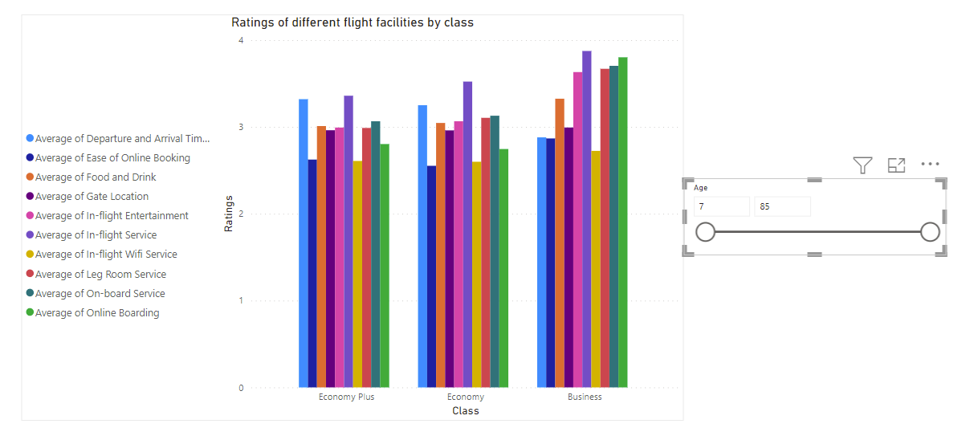
Ratings of different flight facilities by class

